Slide 1
Foundations of Data Science & Analytics (DSCI 633, Fall 2022)
Nidhi Rastogi
Assistant Professor, GCCIS
Rochester Institute of Technology
August 25, 2022

Slide 2
Instructor Introduction
Ph.D. in Computer Science, Rensselaer Polytechnic Institute
M.S. in Computer Science, University of Cincinnati
B.I.T. , Delhi University, India
Worked at GE Global Research, Verizon
Interned at Yahoo, IBM Zurich, BBN Raytheon
Research Interests - Machine learning, Graphs, Security, Autonomous Vehicles, Large distributed networks…

Slide 3
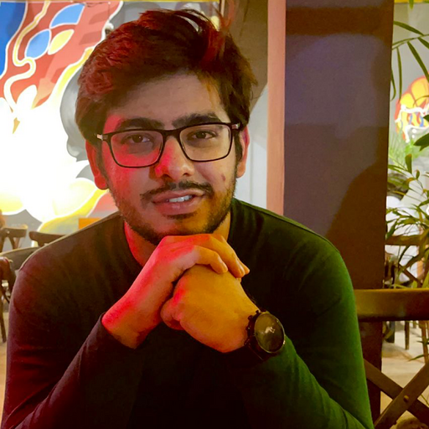
TA Introduction
Addl Tariq
MS Data Science, 2nd Year
TA Hours, email on class GitHub webpage
Also available outside of office hours
Only by appointment – contact on slack or email

Slide 4
Course Information
GitHub link - https://github.com/aiforsec/RIT-DSCI-633-FDS

Slide 5
RIT Data Science Program
Bridge the gap between research and application
The gap is closing thanks to rapid development of softwares
Provide talent with expertise both in data science and software development
"For me, data science is a mix of three things: quantitative analysis (for the rigor necessary to understand your data), programming (so that you can process your data and act on your insights), and storytelling (to help others understand what the data means).”
- Edwin Chen, Data Scientist and Blogger”

Slide 6

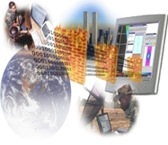
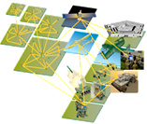

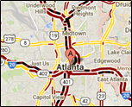


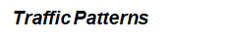
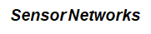
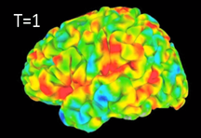
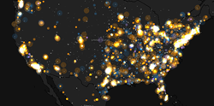
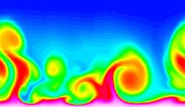
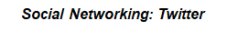
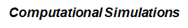
Data Mining is Everywhere
Brain Activity

Slide 7


Behind the Trend (Why?)
Lots of data is being collected and warehoused
Yahoo has Peta Bytes of web data
Facebook has billions of monthly active users
Amazon handles millions of visits/day
Computation has become cheaper and more powerful

Slide 8
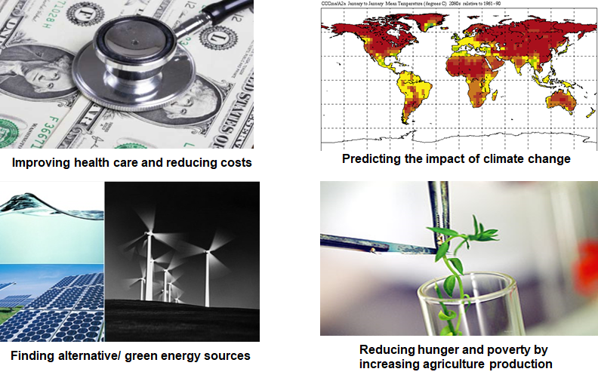

Great Opportunity
Optimizing the development of software

Slide 9
What is NOT Data Mining?
Look up phone number in phone directory
Query a Web search engine for information about “Amazon”
What is Data Mining?
Certain names are more prevalent in certain US locations (O’Brien, O’Rourke, O’Reilly… in Boston area)
Predict whether user want information on Amazon rainforest or Amazon.com when searching for “Amazon”

Slide 10
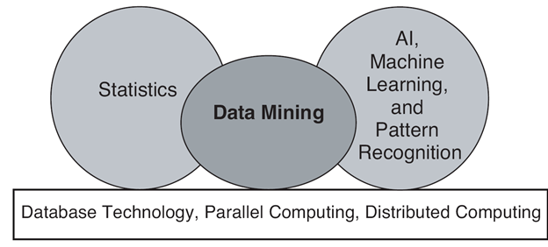
Origin of Data Mining
Especially for data:
Large-scale
High dimensional
Complex
Distributed

Slide 11
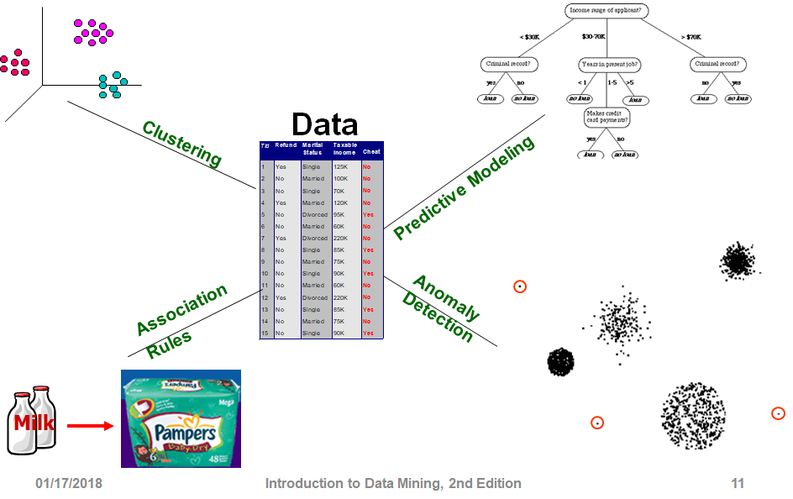
Tasks

Slide 12
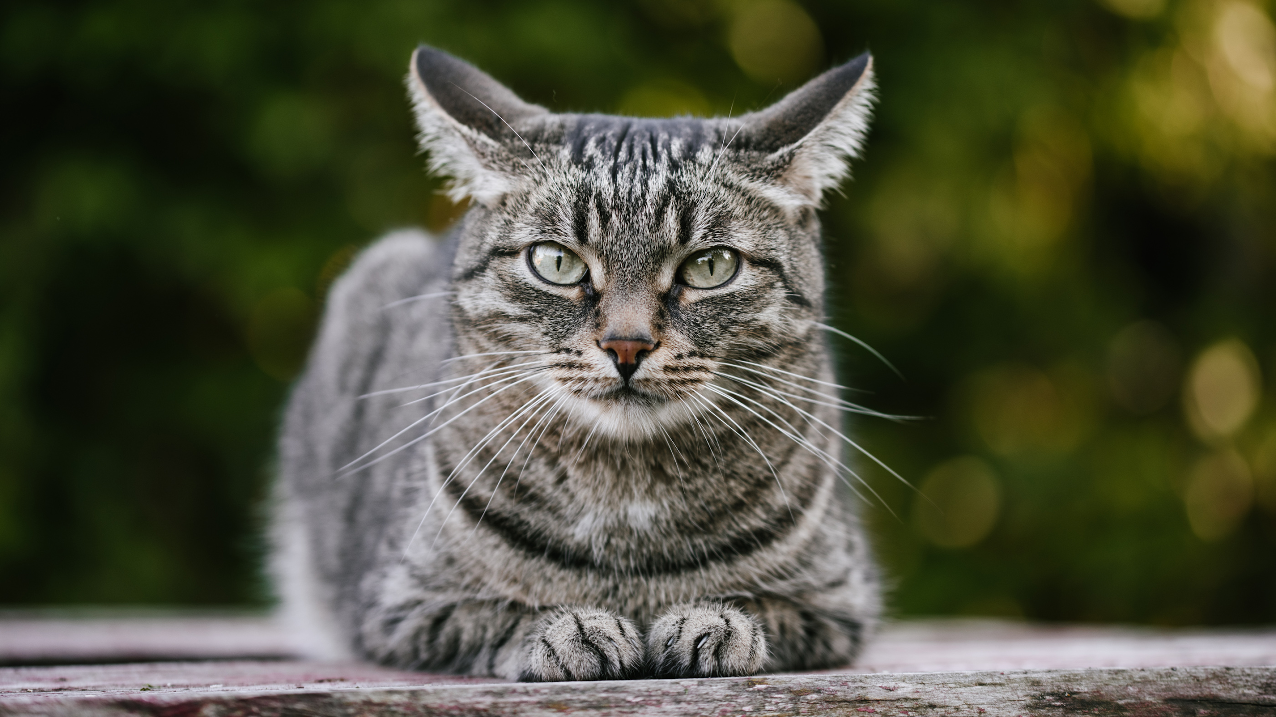
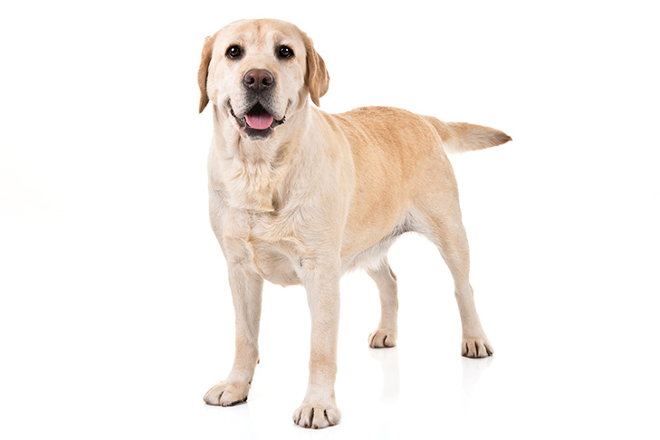
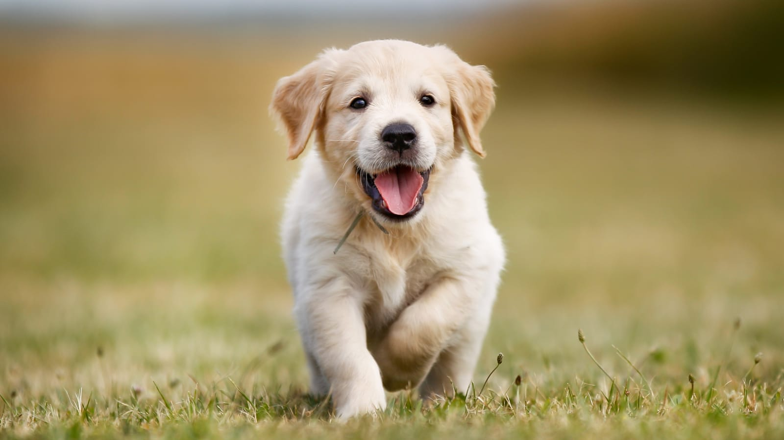
Predictive Modeling (supervised learning)
Independent Variable (Input)
Dependent Variable (Output)
Cat
Train:
Dog
Predict:
?

Slide 13
Predictive Modeling
Output
Classification:
Regression:
Classes / Categories
Continuous Numbers

Slide 14
Predictive Modeling: Classification
Image Classification
Cat
Dog
Bird
Pig
Lion
...

Slide 15
Predictive Modeling: Classification
Sentiment Analysis (NLP)
You have been working on this for months.
I need to see your results, now!
Positive
Neutral
Negative

Slide 16
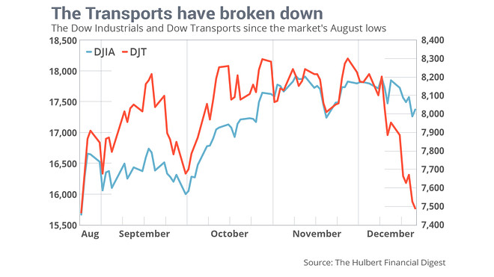
Predictive Modeling: Regression
Time Series Analysis
DJIA and DJT for January?

Slide 17
Predictive Modeling: Regression
ID | Name | Gender | GRE | Coding
001 | Emily Wang | F | 320 | Yes
002 | James Bond | M | 320 | Yes
Problem?
Bias
Score in Foundation of Data Science

Slide 18
Tasks

Slide 19
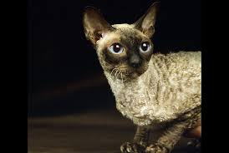
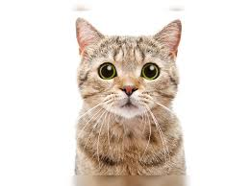
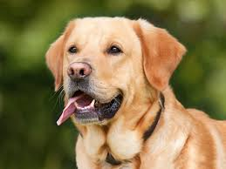
Clustering (unsupervised learning)
Independent Variable

Slide 20
Clustering (unsupervised learning)
Independent Variable

Slide 21
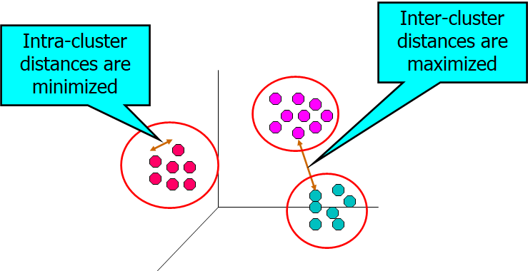
Clustering (objectives)

Slide 22
Clustering (applications)
User ID | Titanic | Die Hard | Avatar
001 | Yes | Yes | No
002 | Yes | No | Yes
Groups of users that like similar movies

Slide 23
Clustering (applications)
Topic Modeling
Area soccer players earn all-state selections.
Sports | Politics | News | Movie
0.4 | 0.18 | 0.4 | 0.02

Slide 24
Tasks

Slide 25
Association Rule Learning
User ID | Titanic | Die Hard | Avatar
001 | Yes | Yes | Yes
002 | Yes | No | Yes
People who watched Titanic will also watch Avatar

Slide 26
Tasks

Slide 27
Anomaly Detection
Purchase | 11/03/2019 | 11/13/2019 | 11/23/2019 | 12/03/2019 | 12/04/2019
001 | Titanic | Avatar | Die Hard | Aliens | Hunter X Hunter

Slide 28
Tasks
Credit card fraud detection
Co-fail test cases
Weather forecast
Community detection on social networks

Slide 29
Preparation for Assignment and Project
Create GitHub account
Fork : https://github.com/aiforsec/RIT-DSCI-633-FDS
Add your GitHub username in this spreadsheet
4. Add Instructor (aiforsec) and Tas (TBD) as collaborators to your forked repository.
Steps to add a collaborator – link
4. Join Slack Channel for the course: #dsci-633-2211

Slide 30
Questions

